Slide 1



Trial@home for children
Novel non-invasive measurements for the clinical trial of the future
Matthijs Kruizinga
MD/PhD
Resident pediatrics
Juliana Children’s Hospital
Centre for Human Drug Research

Slide 2

Clinical care in children
Clinical care in children – in the future
Hospital
Invasive measurements
Big time intervals
One-size fits all
Home
Non-invasive measurements
Continuous
Personalised
Can we do this differently?
New methods
New techniques
Natural environment / real world?

Slide 3
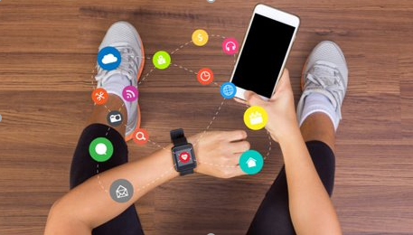
Digital biomarkers
Potential advantages:
Low burden
Cost-reducing
Continuous monitoring
Patiënts have these devices
Potential voor AI treatment advice
Potential for remote clinical trials
Personalized outcome measures
Real-world data
Non-invasive

Slide 4
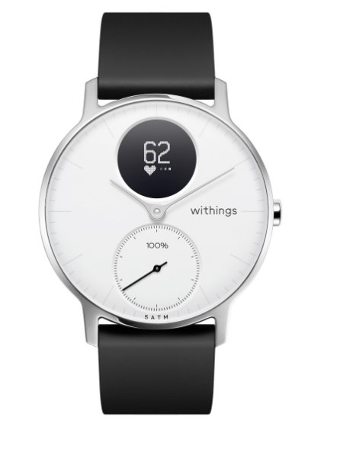
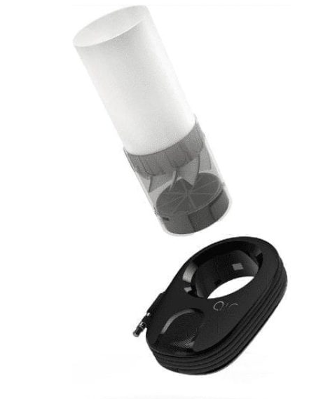
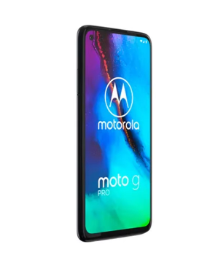
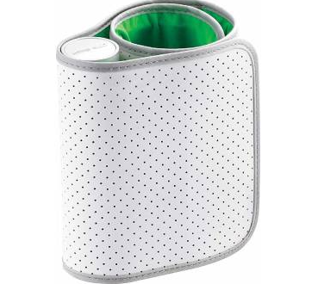
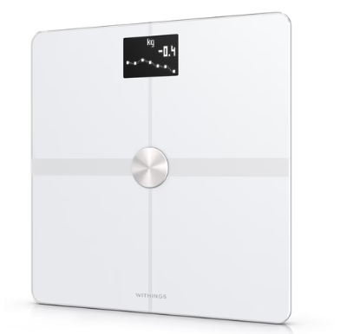
Endpoint selection
Endpoint selection – pediatric asthma/CF

Slide 5
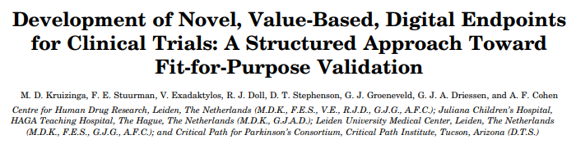
Digital biomarkers
Structured validation
Selection
Technical validation
Clinical validation

Slide 6
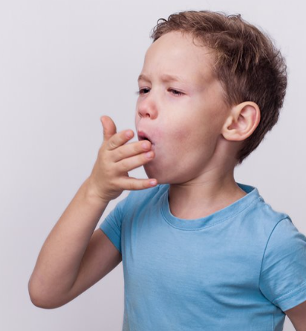
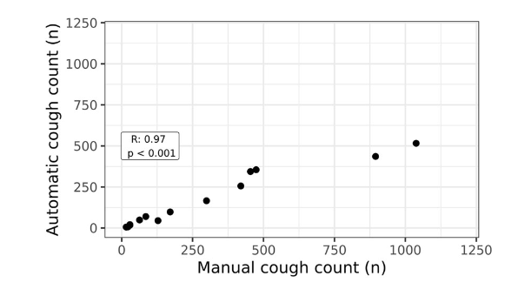
Cough detection algorithm

Slide 7
Clinical validation
Tolerable?
Influencing factors?
Difference healthy-ill?
Correlation traditional measurements?
Detection of events?

Slide 8
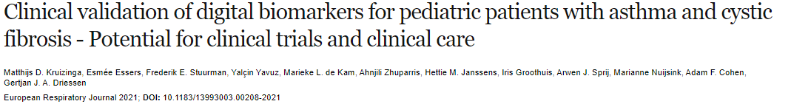
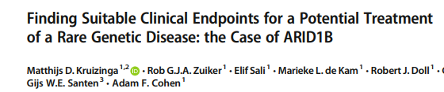
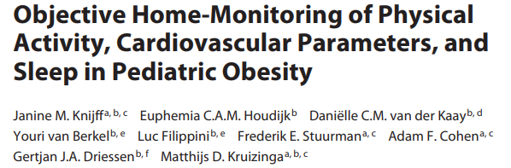
Clinical validation
Tolerable?
Influencing factors?
Difference healthy-ill?
Correlation traditional measurements?
Detection of events?

Slide 9
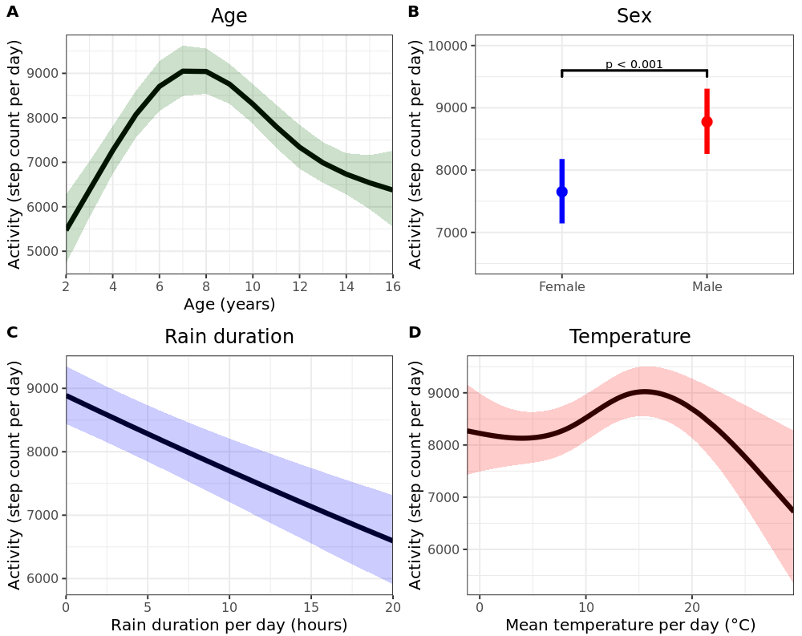
Clinical validation
Tolerable?
Influencing factors?
Difference healthy-ill?
Correlation traditional measurements?
Detection of events?

Slide 10
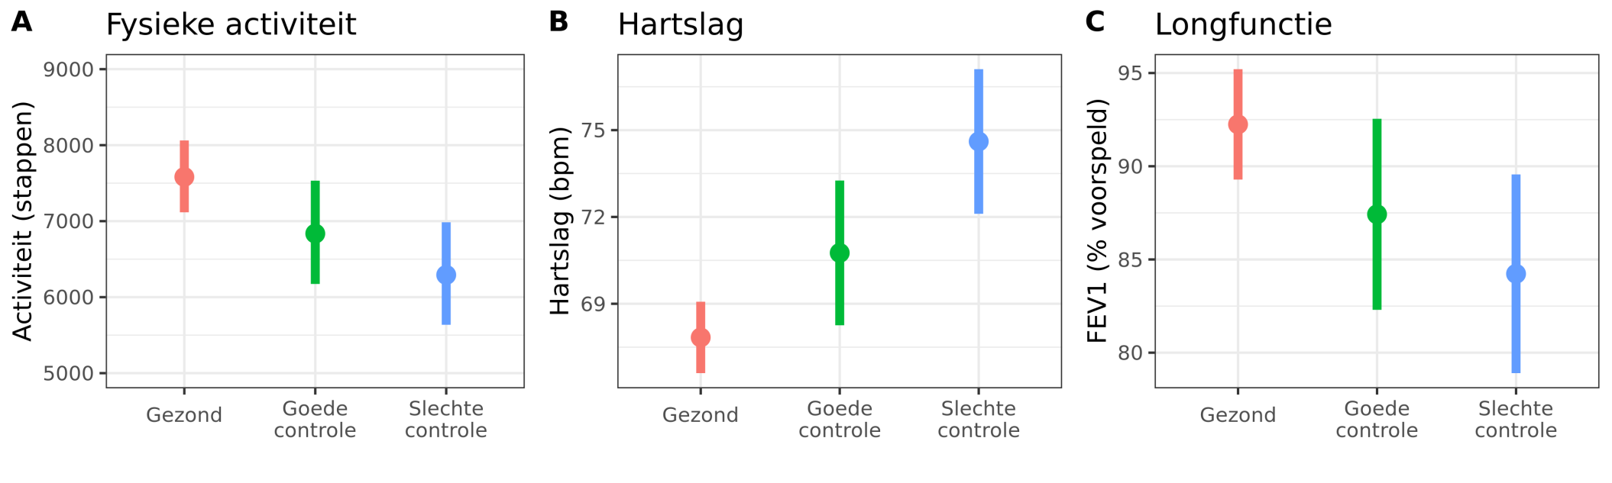
Clinical validation
Tolerable?
Pediatric asthma
Influencing factors?
Physical activity
Heart rate
Pulmonary function
Difference healthy-ill?
Correlation traditional measurements?
Healthy
Good control
Bad control
Healthy
Good control
Bad control
Healthy
Good control
Bad control
Detection of events?

Slide 11
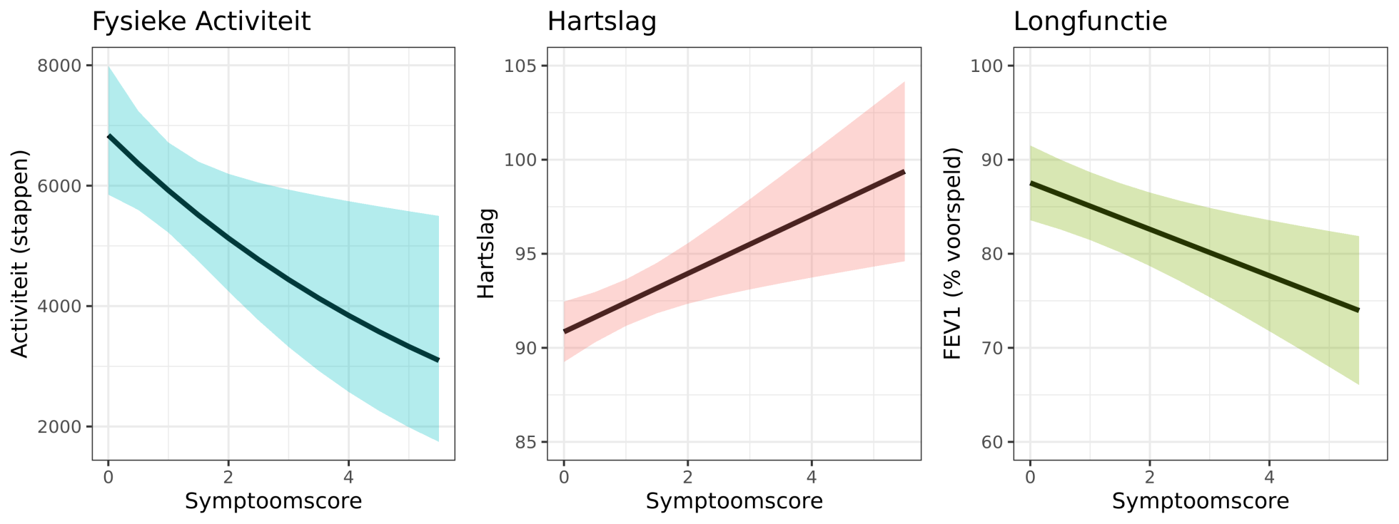
Clinical validation
Tolerable?
Pediatric asthma
Physical activity
Heart rate
Pulmonary function
Influencing factors?
Difference healthy-ill?
Correlation traditional measurements?
Detection of events?

Slide 12
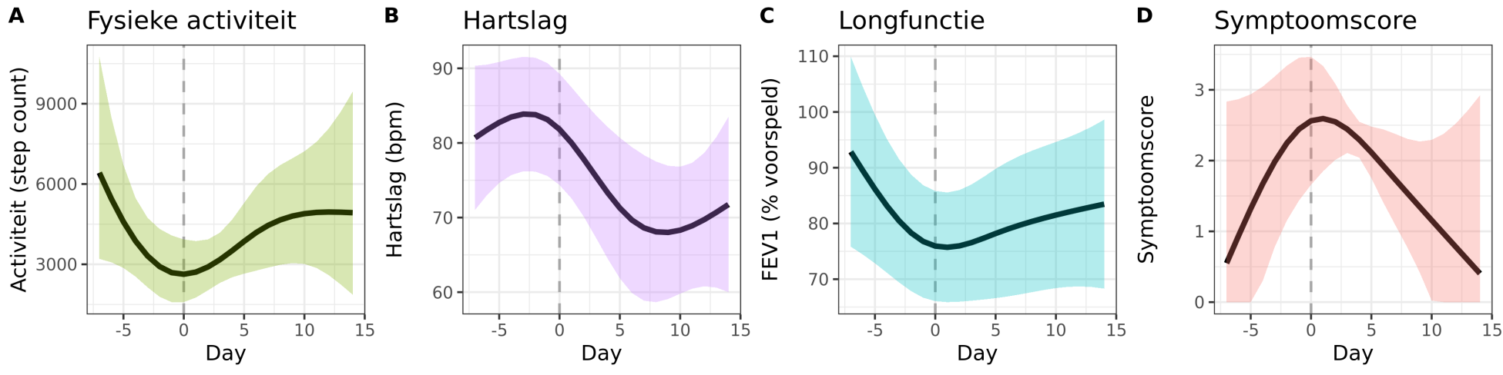
Clinical validation
Tolerable
Pediatric asthma
Influencing factors?
Physical activity
Heart rate
Pulmonary function
Symptom score
Difference healthy-ill?
Correlation traditional measurements?
Detection of events?

Slide 13
Clinical validation of smartwatch wearable data pediatric asthma
Tolerability High compliance
Effect modifiers Age, sex, weather
Difference patients controls Yes
Correlation traditional endpoints Yes
Description of health events Yes
Next step: ?

Slide 14
Future implementation clinical care
Individual symptom prediction
Spirometry
Cough detection
Symptom diary
Physical activity
Heart rate
Sleep monitoring
Improved outcomes?
Individual treatment advice

Slide 15
Study proposal
Objective:
To develop an algorithm based on non-invasive biomarkers that is able to predict asthma exacerbations
… in order to perform a timely intervention preventing hospital visits and admissions

Slide 16
Study design
Sample size calculation?
Population:
Patients with (uncontrolled) asthma: n =100
Patients with cystic fibrosis: n =50
Observational study using spectrum of home-monitoring techniques
12 months total
8 months ‘training/testing period’
Baseline ‘normal’, show exacerbation phenotype
4 months ‘validation period’
Validation of developed model(s)
Open for debate

Slide 17
Included data
Local parameters
Weather
Air pollution
Pollen counts
Active monitoring
Pulmonary function
Symptom diary
Patient data
Passsive monitoring
Smartwatch Data
Heart rate
Physical activity
Sleep duration
Nocturnal cough count
Medication sensor
Reliever use
Controller compliance
Disease Activity
Severe Exacerbation
Moderate exacerbation
Predictive model

Slide 18
Statistics and analysis
Population model
Generalized model applicable to existing and future subjects
To be used during training of new subjects
RF / naïve Bayes / SVM / neural network
Personalized model(s)
Time-series model
Predict probability of event in the next x days
Refinement?

Slide 19
Envisioned (future) implementation
Phase | Learning/training | Implementation | Iterative learning
Goal | Collect data to build individual algorithm. | Implement the individual algorithm to | Re-validate the algorithm with a new rich dataset.
Duration | 2-8 months* | 6 months | 0.5-1 month, with 6–12-month intervals
Data collection | All parameters | Parameters relevant for the individual algorithm | All parameters
Active algorithm | Population algorithm | Individual algorithm | Individual algorithm

Slide 20

Care@home
Implementation of digital biomarkers in clinical care
Selection
Technical- and clinical validation
Study proposal
Home-monitoring with digital biomarkers in asthma and CF
Implement complete spectrum of home-monitoring techniques
Develop population and individual models to predict exacerbations

Slide 21
Co-investigators
Prof dr. Edward Dompeling (MUMC)
Dr. Hettie Janssens (Sophia Children’s Hospital)

